Slide 1
Stock Price Prediction via
Sentiment Analysis vs Recurrent Neural Network
Chris SY Choi
Charlene (Shihui) Guo
Siddharth Dave
Vaishali Tanwar

Slide 2
Questions to look out for!!
Does everyday news headlines have an affect on the stock price trend?
Does the past stock price affect the future price?
Is news the only factor affecting the prices?

Slide 3





Data Sources
Yahoo Finance Library
Reuters news headline archives
Technewsworld headlines archives
New York Times Archive API

Slide 4


Machine Learning Models
Sentimental Analysis: Random Forest Classifier (NLP)
Price Analysis: Recurrent Neural Network (RNN)

Slide 5
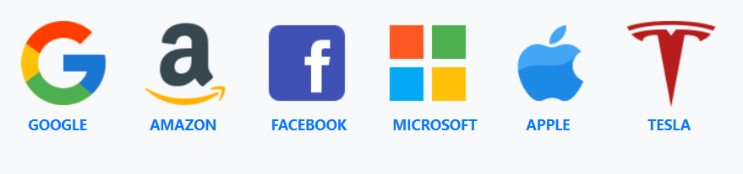
Subject Tech Companies

Slide 6
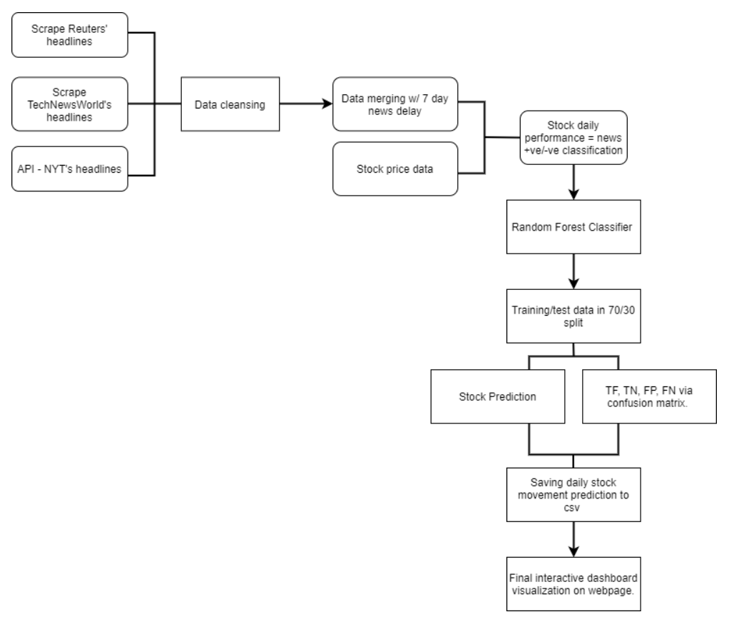
Workflow - NLP

Slide 7
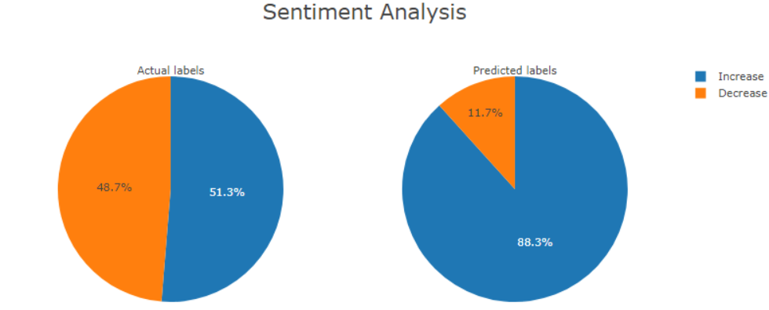
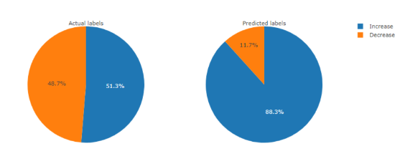
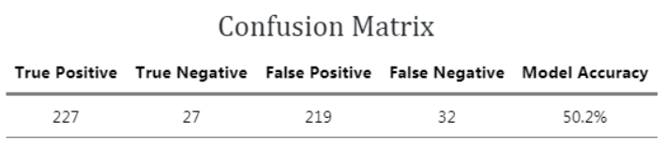
Stock Predictions - NLP
Google Trend (for last 2 years)

Slide 8
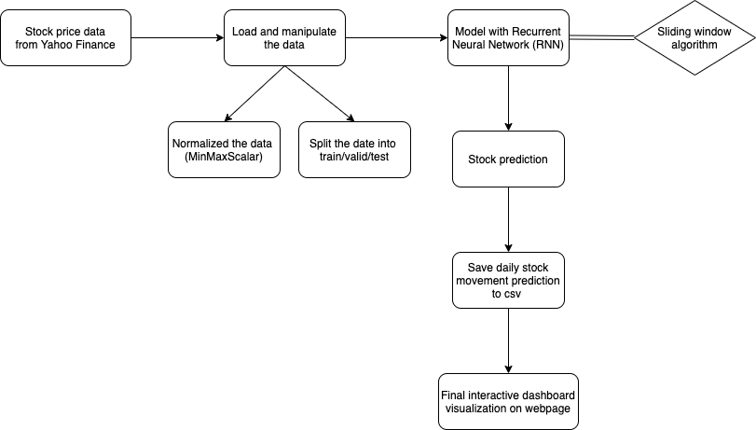
Workflow - RNN

Slide 9
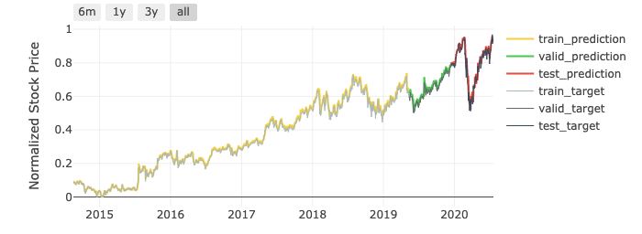
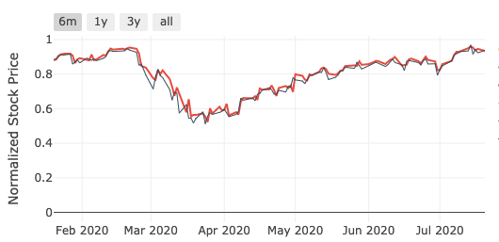
Stock Prediction - RNN
Google (GOOGL)
2014-2020
6 Month Target vs. Prediction

Slide 10
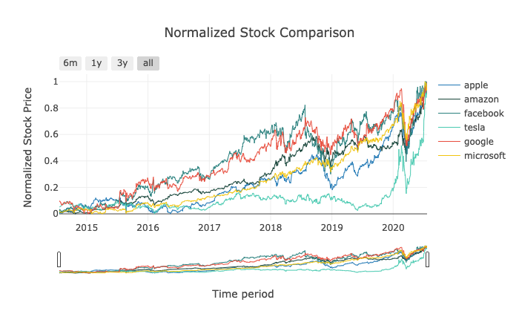
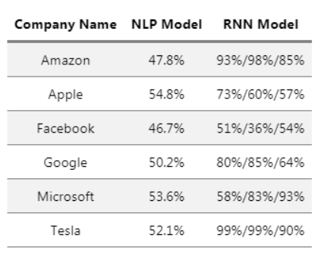
NLP vs. RNN Model Comparison
Normalized Stock Comparison
RNN Model Limitations
2014-2020
Why NLP model has low accuracy?
Sliding Window Algorithm
Limited to historical data
Other factors affecting the fluctuation of the stock
Sentimental Analysis:
Quality of news data
Quantity of new data
Correlation vs Causation

Slide 11
Conclusions
News does have an affect on the stock price trend but only sentimental analysis is not enough to accurately predict the trend.
Historical stock price trend does affect the future trend but its still not enough to accurately predict the stock price.
News headline does have an effect on investors’ sentiment to invest in a particular company but there are numerous other factor that cumulatively affect the stock price.
Integrating the NLP model and RNN model might show improvement in the accuracy.

Slide 12

THANK YOU

Slide 13


